Slide 1
Extensions of the Turing machine

Slide 2
Extending the Turing Machine
Extend the standard Turing machine in various ways
But additional features do not add to the classes of computable functions or decidable languages !
The extended machine can be simulated by the standard model
However, it can be easier to use additional features when designing Turing machines to solve particular problems

Slide 3
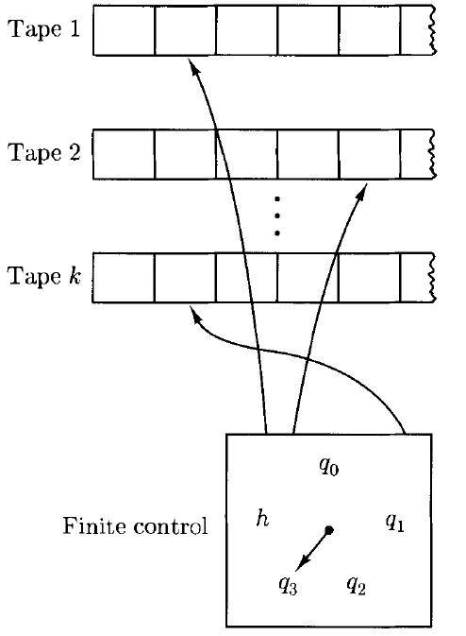
Multiple Tapes

Slide 4
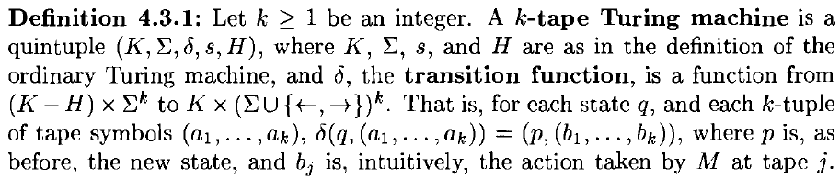

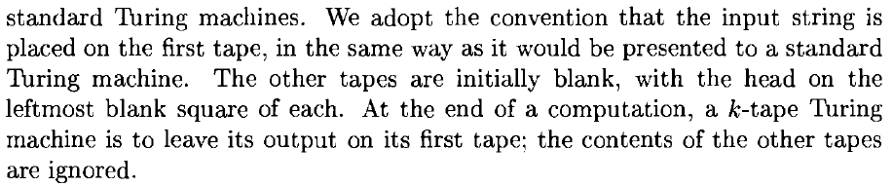
Multiple Tapes

Slide 5
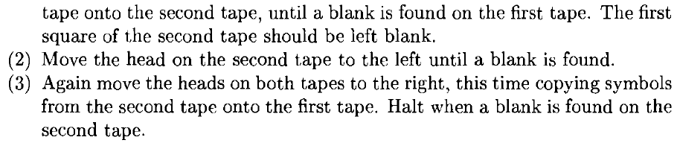
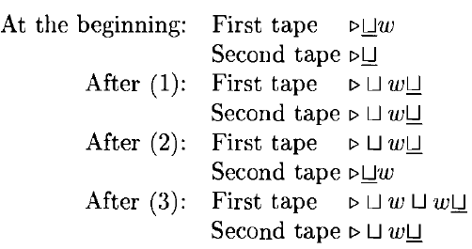
Copying Machine

Slide 6
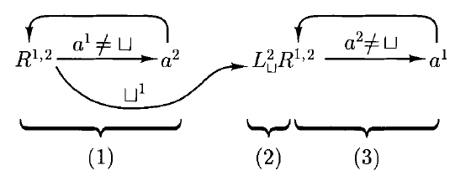
Copying Turing Machine with Two Tapes

Slide 7
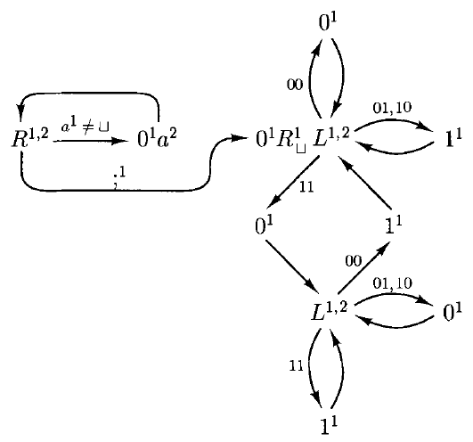
Add Arbitrary Binary Numbers

Slide 8
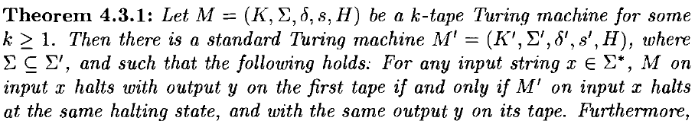
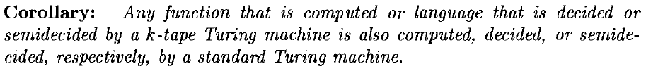
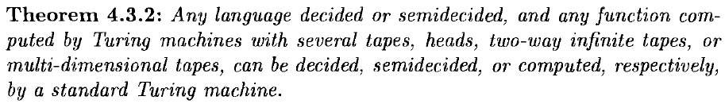
Multiple Tape Turing Machine

Slide 9
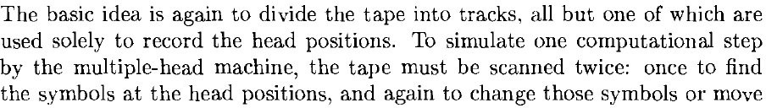

Other Extensions to Turing Machine
Two-way Infinite Tape
Multiple Heads
Two-Dimensional Tape

Slide 10
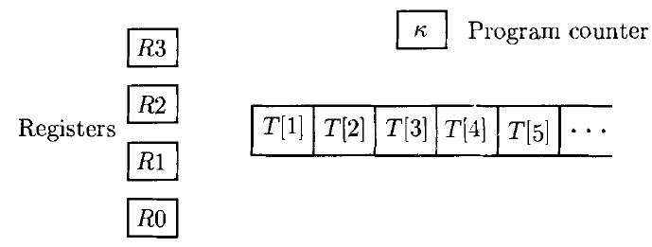
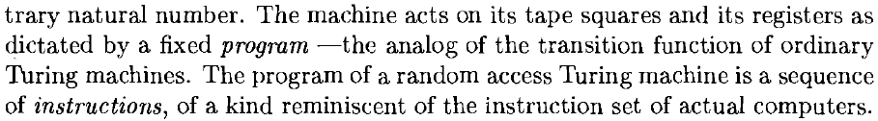
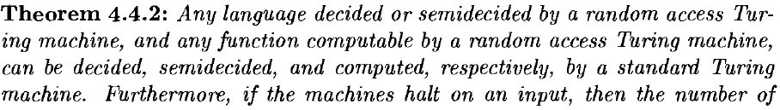
Random Access Turing Machine

Slide 11
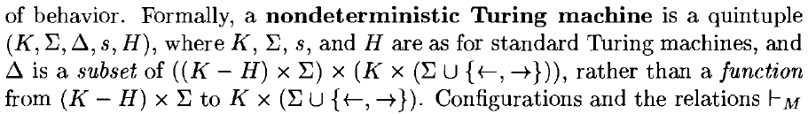
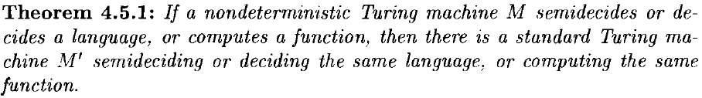
Nondeterministic Turing Machines

